Slide 1
Course
Essential Skills for Youth Data Literacy in Pakistan
Notes:
(start of intro/ first section) Welcome to Youth Policy Lab's Practice School. I am _______________, the facilitator for this course.

Slide 2
Course Plan
Section 1
Youth Data Literacy Essentials
What are Data?
What are the different types of data?
What is youth data literacy?
Why does it matter?
Which data do I choose to focus on?
Section 2
How to navigate Youth Data
Where is reliable youth data found?
Some basic analysis terms
How can youth data be understood?
How to create new data?
What is data privacy?
What is data sovereignty?
Section 3
How to use youth data effectively
Why do you need data?
How can youth data be used to influence change?
How to identify stakeholders
How can youth data be communicated effectively?
Assessment
Online Quiz (100% weightage for certificate of qualification)
Notes:
In this section, we will learn __________________.

Slide 3
Section 1
Youth Data Literacy Essentials

Slide 4
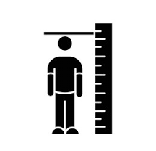
What are Data?
Data are measurements or observations that are collected as a source of information. There are a variety of different types of data, and different ways to represent data. The number of people in Pakistan, the countries where people were born, number of calls received by the emergency services each day, the value of sales of a particular product, or the number of times Pakistan has won a cricket match, are all examples of data. A data unit is one entity (such as a person or business) in the population being studied, about which data are collected. A data unit is also referred to as a unit record or record. A data item is a characteristic (or attribute) of a data unit which is measured or counted, such as height, country of birth, or income. A data item is also referred to as a variable because the characteristic may vary between data units, and may vary over time. An observation is an occurrence of a specific data item that is recorded about a data unit. It may also be referred to as datum, which is the singular form of data. An observation may be numeric or non-numeric (categorical). For example, 173 is a numeric observation of the data item 'height (cm)', whereas ‘Pakistan' is a non-numeric (categorical) observation of the data item 'country of birth'. A dataset is a complete collection of all observations.
Source: Australian Bureau of Statistics, Statistical Language https://www.abs.gov.au/websitedbs/D3310114.nsf/Home/Statistical+Language+-+what+are+data
Notes:
All information can be turned into data and all data is information.

Slide 5
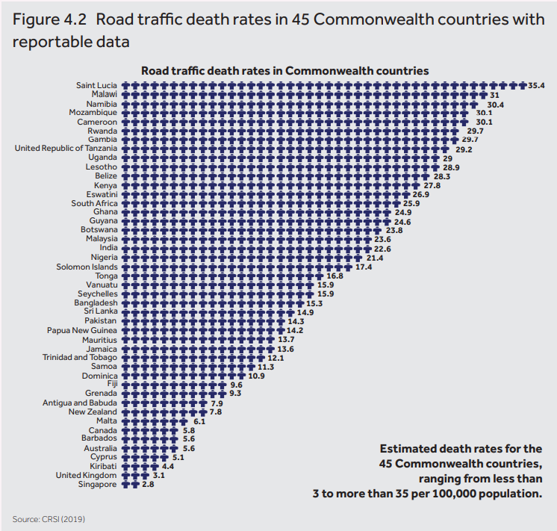
What are the different types of data?
2020 Global Youth Development Index indicators
Domain | Indicator | Definition
Health & Wellbeing | Mortality rate | Deaths from all causes, ages (15-24yrs)
 | HIV rate | HIV rate (15–24yrs)
 | Self-harm | Years of life lost (YLL) from selfharm (15-29yrs)
 | Mental health | YLL from mental disorders (15-29yrs)
 | Drug abuse | YLL from drug use disorders (15-29yrs)
 | Alcohol abuse | YLL from alcohol use disorders (15-29yrs)
 | Tobacco consumption | Tobacco smokers, % of ages
Education | Literacy rate | Literacy rate (15-24yrs)
 | School completion | Lower secondary completion rate
 | Digital natives | Five or more years’ experience using the internet (15-29yrs)
Employment & Opportunity | Not in education, employment or training (NEET) | % NEET youth (15–24yrs)
 | Underemployment | % Time-related underemployment (15-24yrs)
 | Adolescent fertility rate | Births per 1,000 women (15–19yrs)
 | Account | Respondents who report having an account past 12 months (15-24yrs)
Equality & Inclusion | Gender parity in NEET | Distance from parity between % NEET male and female (15-24yrs)
 | Gender parity in safety and security | Distance from parity between % male and female report feeling safe walking alone in their neighbourhood
 | Gender parity in literacy | Literacy Gender Parity Index
 | Early marriage | % of women (20-24yrs) first married by age 18
 | Economic marginalisation | Population percentage classified as extremely poor
Political & Civic Participation | Youth policy score | Scores on youth policy and legislation, public institutions, youth representation, and public spending
 | Voiced opinion to an official | % voiced their opinion to an official in last 30 days (15-29yrs)
 | Volunteered time | % volunteered time in the past 30 days (15-29yrs)
 | Recognition for community improvement | % received recognition for helping to improve the city or area where live (15-29yrs)
Peace & Security | Internal peace score | Composite score for domestic peace and safety and security
 | Interpersonal violence | YLL from interpersonal violence (15-29yrs)
 | Conflict and terrorism | YLL from armed conflict and terrorism (15–29yrs)
 | Index for Risk Management (INFORM) score | Risk of humanitarian crisis and disaster, including climate change related risks
Source: Commonwealth Secretariate, 2020 Global Youth Development Index, https://youth-development-index.thecommonwealth.org/assets/pdf/global-youth-development-report-2020.pdf
Notes:
There are different types of data:
Statistical data where numbers are used to compare, e.g. over time from one year to the next or between provinces. Usually from Surveys.
Data from other sources such as focus groups and interviews and reports.
All are valid and important sources of data.
Quantitative data are measures of values or counts and are expressed as numbers. Quantitative data are data about numeric variables (e.g. how many; how much; or how often). Qualitative data are measures of 'types' and may be represented by a name, symbol, or a number code. Qualitative data are data about categorical variables (e.g. what type). (Australian Bureau of Statistics https://www.abs.gov.au/websitedbs/D3310114.nsf/Home/Statistical+Language+-+quantitative+and+qualitative+data )
There is good quality data and unreliable data. Good data is gathered in a certain way which has reliable and tested methodology and is representative with enough responses.
Data can be unreliable because it was not gathered correctly or is not tested for accuracy by methods that are fit for purpose including using the wrong questions or sources.

Slide 6
What is Youth Data Literacy?
“Data-literacy is the ability to consume for knowledge, produce
coherently and think critically about data.”
Data literacy includes:
Statistical literacy
Understanding how to work with large data sets,
How they were produced,
How to connect various data sets, and
How to interpret them.
See more at:
http://datajournalismhandbook.org/1.0/en/understanding_data_0.html#sthash.4oLwYHgy.dpuf
Notes:
Data is everywhere and massive part of all of our lives! Data literacy is the ability to read data, work with data, and communicate about data by putting it in proper context. (https://venngage.com/blog/data-literacy/)

Slide 7
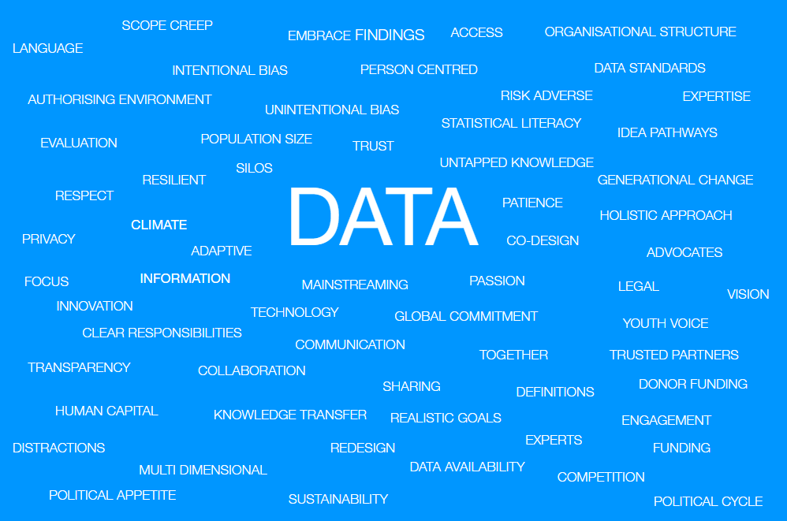
Why does it matter?
Source: Numbers and People Synergy, Fifty-fifth session of the Commission for Social Development on “Promoting Integrated Policies for Poverty Eradication: Youth Development in the 2030 Agenda”, United Nations, New York, January 2017
Notes:
Data is central to most work places and most issues of life. It can be used as an evidence base for policy, programs, life decisions, TV scheduling and a lot more.

Slide 8
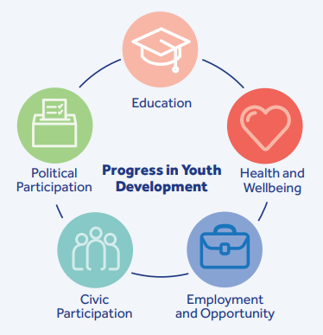
Which data do I choose to focus on?
Source: Commonwealth Secretariate, 2016 Global Youth Development Index
Notes:
What would you like to see improve about life in Pakistan? This can be quite a personal question. Perhaps it is something difficult that you have experienced personally in your life or someone close to you that you would like to have seen happen differently. Such as better access to a hospital, more computers and faster internet speed during education, better transport or access to a loan for a business idea. Each of these points of pain is an opportunity for improvement in how society is organised. Using the right data can help to influence this change.
Activity - Write down one thing is society you would like to see improve.
Now that you have your topic, which data is the right data to help understand this topic? Those who work every day with the topic that interests you are good people which data is important to focus on. For example, the education department will have reports on what is measured and what is important and why, such as the reasons people may not be able to finish education.
Finding the right people or departments who already know about your topic of interest is the first place to know which data to focus on.

Slide 9
How to get the most out of your data?
How can we increase accountability if we can’t rely on the numbers?
To be considered fit for purpose most quality frameworks look for similar attributes of data which include:
Trustworthy
Relevant
Timely
Accurate
Interpretable
Accessible/Public
Coherent
Fit for Purpose
Source: Numbers and People Synergy adaptation from UN data quality assurance, www.numbersandpeople.com

Slide 10
Resources
Australian Bureau of Statistics, Statistical Language https://www.abs.gov.au/websitedbs/D3310114.nsf/Home/Statistical+Language+-+what+are+data
Commonwealth Secretariate, 2020 Global Youth Development Index, https://youth-development-index.thecommonwealth.org/assets/pdf/global-youth-development-report-2020.pdf
DataJournalism.com, http://datajournalismhandbook.org/1.0/en/understanding_data_0.html#sthash.4oLwYHgy.dpuf
Finance Division, Government of Pakistan https://www.finance.gov.pk/
Kamyab Jawan, National Development Youth Programme https://kamyabjawan.gov.pk/
Ministry of Federal Education and Professional Training, Government of Pakistan http://www.mofept.gov.pk/
Ministry of National Health Services Regulations and Coordination, Government of Pakistan https://nhsrc.gov.pk/
Open Data, National Center for Big Data and Cloud Computing (NCBC), Lahore University of Management Sciences (LUMS) and Higher Education Commission (HEC), https://opendata.com.pk/
Pakistan Bureau of Statistics https://www.pbs.gov.pk/
UN Data https://data.un.org/
UNFPA Pakistan https://pakistan.unfpa.org/en
United Nations Sustainable Development Goals SDG Indicator Database https://unstats.un.org/sdgs/dataportal
World Bank Open Data https://data.worldbank.org/
Youth Parliament Pakistan, https://youthparliament.pk/
Notes:
Thank you for participating in this course co-developed by UNDP Pakistan and UNICEF Pakistan. Please complete the next sections and the available course assessment for gaining a certificate of qualification for this course.

